Slide 1

ScamShield AI
Fake Job & Internship Scam Detection System
Detect. Explain. Report. Protect, before you pay.
TEAM MEMBERS:
SIVADHARSHINI S
SRUTHIKS G
SUBIKSHA D
YOGALAKSHME M
Notes:
Open with the one-line pitch: every year, students lose money and documents to fake job offers. ScamShield AI tells you if an offer is risky, explains why, and helps you act, in seconds.

Slide 2
Presentation Overview:
Objective
The Problem
The Solution
Two Sides Of The Problem
System Architecture
Student Mode
Recruiter Mode
Modules Used
Output Screenshots
Technology Used
Conclusion
Future Work
Notes:
Ask the audience: has anyone received a job offer that asked for money? Then explain the three common patterns, and mention that recruiters have the opposite problem with fake resumes.

Slide 3
OBJECTIVE:
Help students spot fake job and internship offers before paying any money.
Give a clear risk score (Low, Uncertain or High) and explain why, with highlighted risky words.
Read screenshots and PDF offer letters, and help recruiters verify resumes.
Make reporting easy with a complaint draft and a safe reply, only when an offer looks like a scam.
Spread awareness with company reviews, a live dashboard and the “Scam or Real?” game.
Notes:
Ask the audience: has anyone received a job offer that asked for money? Then explain the three common patterns, and mention that recruiters have the opposite problem with fake resumes.

Slide 4



THE PROBLEM
Registration fee scams
Document harvesting
Hidden in chat screenshots
Students are asked to pay a fee or deposit to confirm a job that does not exist.
Aadhaar, PAN and bank details are collected through fake offer letters and forms.
Most scams arrive as WhatsApp or Telegram messages that are hard to verify.
Many students get fake job offers.
Scammers ask for a fee to “confirm” the job.
They collect Aadhaar, PAN and bank details.
Most scams come as WhatsApp or Telegram messages.
Recruiters also get fake resumes.
ScamShield AI · 02
Notes:
Ask the audience: has anyone received a job offer that asked for money? Then explain the three common patterns, and mention that recruiters have the opposite problem with fake resumes.

Slide 5



THE SOLUTION
Detect
Explain
Report
A risk score from an ML model, a rule engine and a domain check, with an honest Uncertain band.
Highlighted words and a red-flag list show exactly why an offer looks risky.
A complaint draft with cybercrime.gov.in and 1930 helpline details, plus a shareable alert card.
Audience feedback: the audience votes in “Scam or Real”, and users can review companies they applied to or worked with
Live dashboard: shows scans by scam type, top red-flag words and risk levels
One-click complaint draft: ready for cybercrime.gov.in, with the 1930 helpline
Safe reply helper: questions to ask a recruiter, like their official company email and interview time
ScamShield AI · 03
Notes:
Walk through the three verbs. Stress that the result is a risk indicator, and that the tool explains itself rather than giving a black-box verdict.

Slide 6


Two modes, one platform
TWO SIDES OF THE PROBLEM
Student Mode
Recruiter Mode
For students and freshers
For recruiters and placement cells
Paste a posting or a chat
Upload a screenshot or offer letter PDF
Get a risk score, scam type and advice
Draft a complaint
Upload a resume PDF
Check the timeline and hidden text
Compare with public resumes
Get verification flags and interview questions
ScamShield AI · 04
Notes:
The two-sided product is what makes this more than a classifier: it protects the job seeker and helps the recruiter.

Slide 7
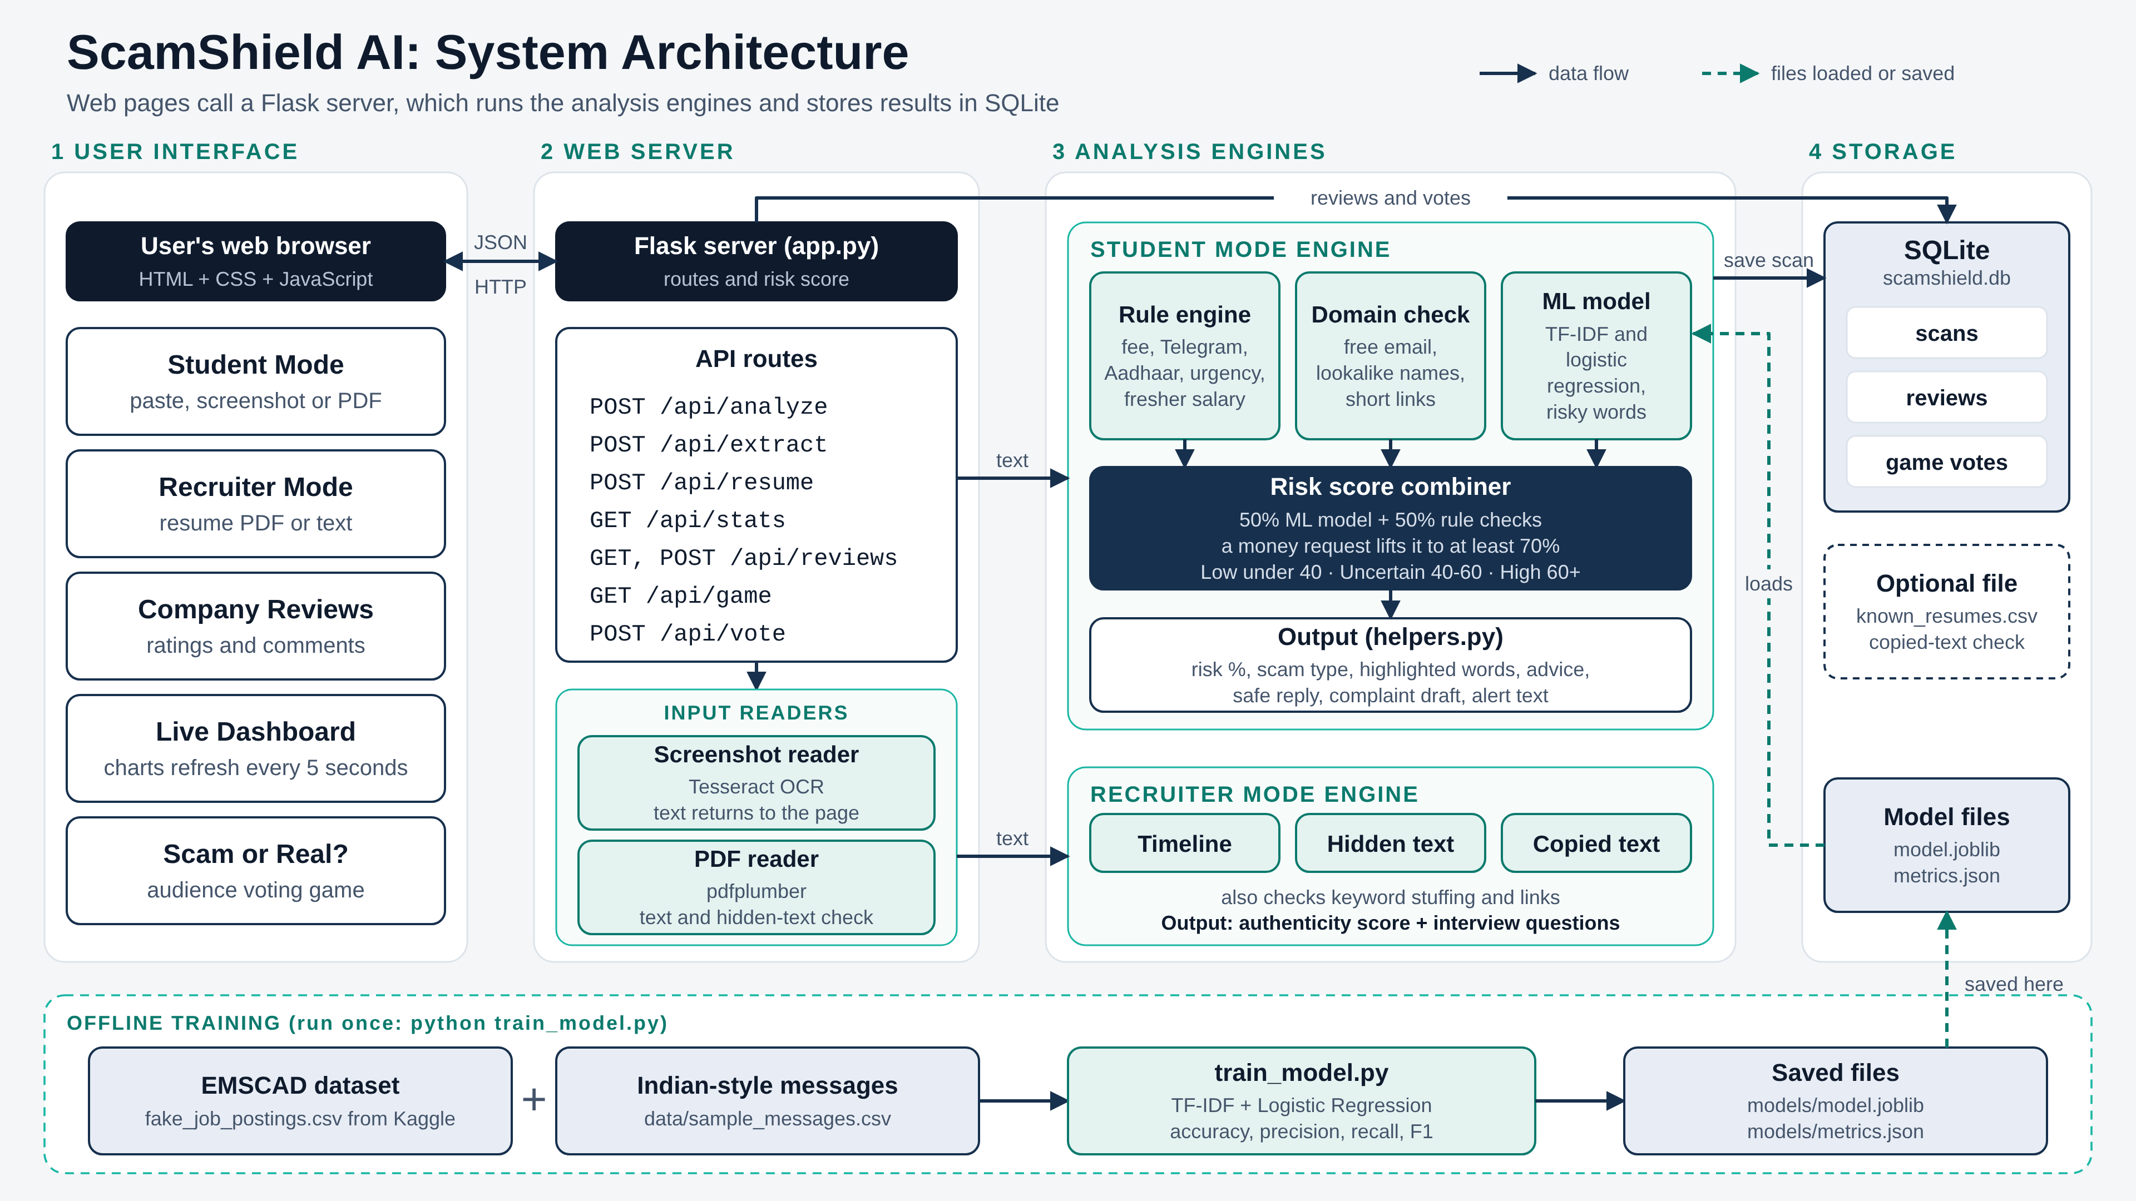
Notes:
Follow one message through the pipeline. The three checks run side by side and are combined into one score, so a single weak signal never decides the result alone.

Slide 8






STUDENT MODE
Screenshot scanner
Domain check
Scam type
OCR reads WhatsApp and Telegram screenshots.
Domain age, free email use and lookalike names.
Fee, document harvesting, fake offer letter, task or MLM.
Explainable score
Complaint draft
Tamil and Tanglish
Highlighted words, red flags and an Uncertain band.
Pre-filled for cybercrime.gov.in, with the 1930 helpline.
Rules for scam messages that mix languages.
ScamShield AI · 06
Notes:
Pick two or three to demo live: the screenshot scanner, the highlighted words and the complaint draft land best with an audience.

Slide 9
Verification flags for resumes
RECRUITER MODE
Check | What it finds
Timeline consistency | Overlapping jobs, impossible dates, experience that does not fit the graduation year
Hidden text | White or tiny keyword stuffing added to fool screening software
Copied content | Similarity to a public resume dataset, using sentence embeddings
Interview questions | One question for each doubtful claim, so recruiters can act
Results are verification flags, never a verdict. Shows “flags to verify”, never “this person is fake”
ScamShield AI · 07
Notes:
Explain that there is no public labeled dataset of fake resumes, so this mode is rule and consistency based. That is the honest approach, and the interview questions are the most useful output.

Slide 10
Modules Used:
Input: text, screenshot or PDF
Text Extraction: OCR and PDF reader
ML Model: TF-IDF + Logistic Regression
Rule Engine: checks red flags (fees, Telegram, urgency)
Risk Scoring: Low, Uncertain or High
Explainability: highlights risky words
Resume Check: finds fake or unusual resume signs
Response Helper: safe reply and complaint draft
Reviews and Dashboard: feedback and live charts
Notes:
Ask the audience: has anyone received a job offer that asked for money? Then explain the three common patterns, and mention that recruiters have the opposite problem with fake resumes.

Slide 11
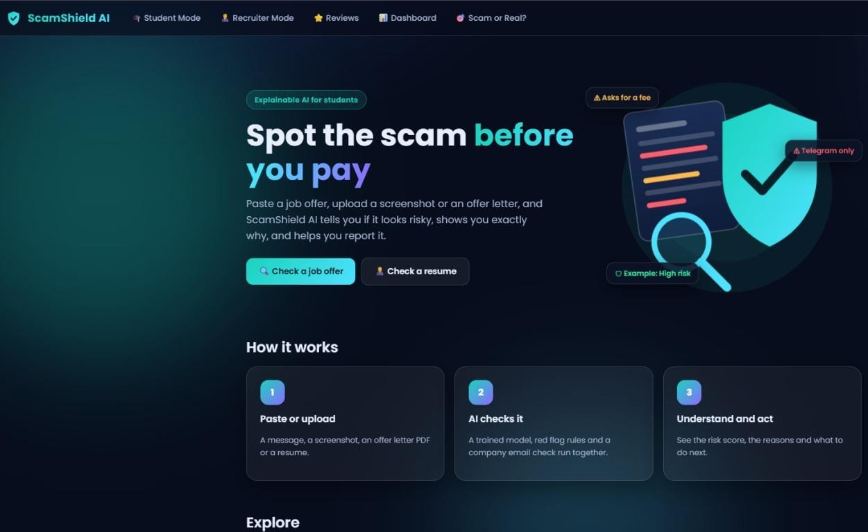
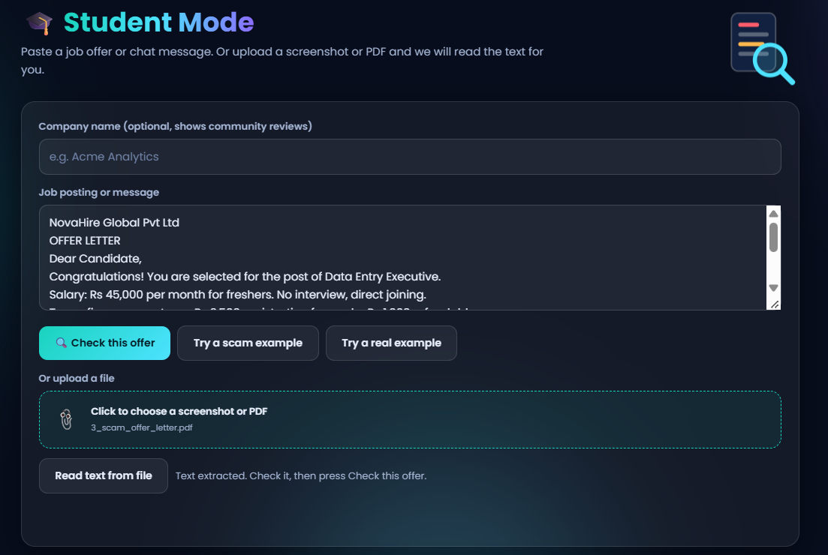
OUTPUT SCREENSHOT:
Notes:
Ask the audience: has anyone received a job offer that asked for money? Then explain the three common patterns, and mention that recruiters have the opposite problem with fake resumes.

Slide 12
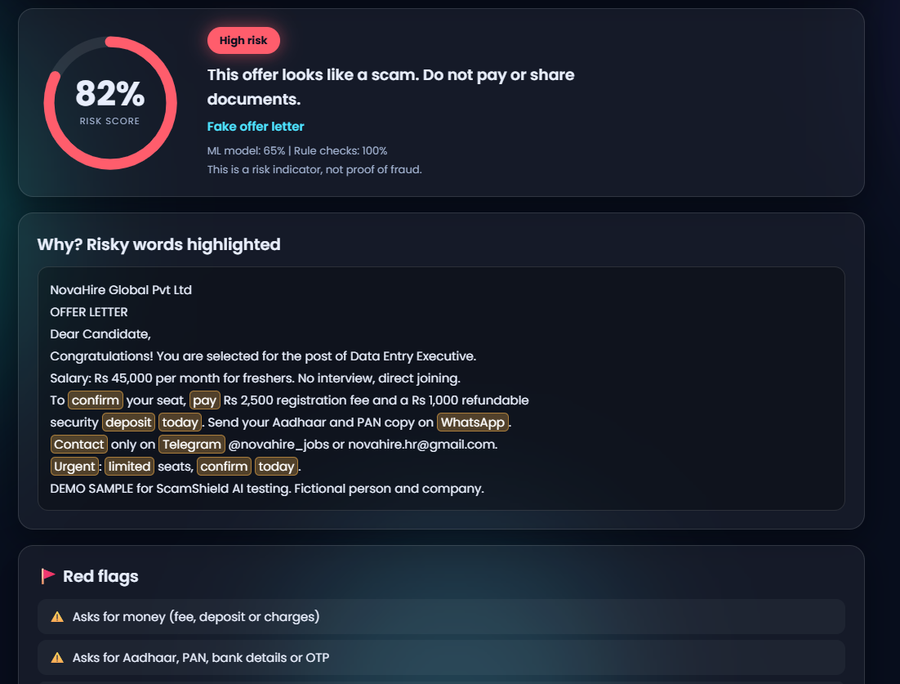
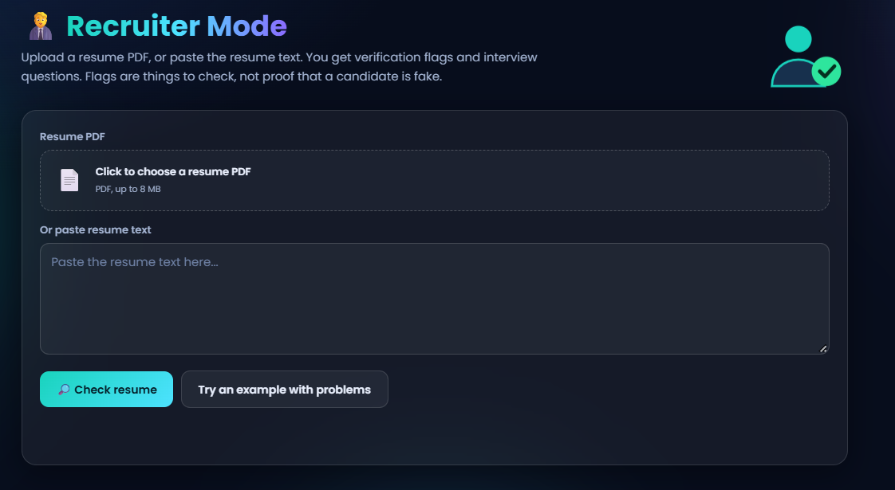
OUTPUT SCREENSHOT:
Notes:
Ask the audience: has anyone received a job offer that asked for money? Then explain the three common patterns, and mention that recruiters have the opposite problem with fake resumes.

Slide 13
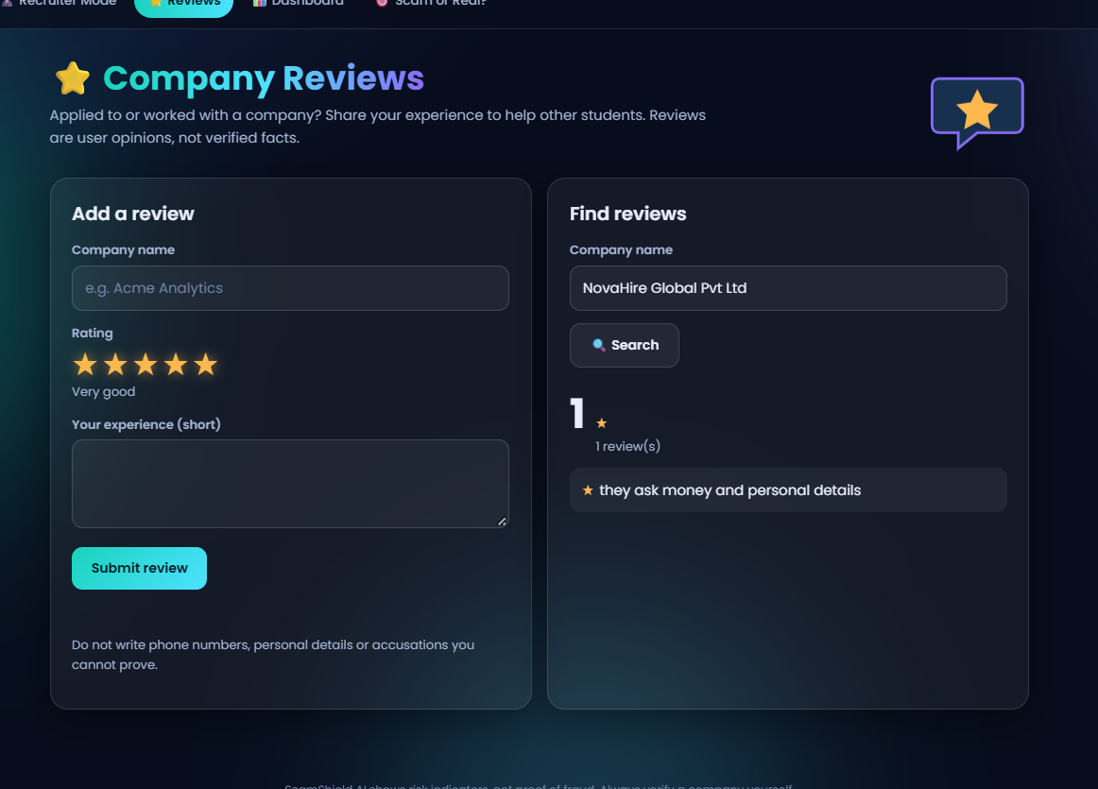
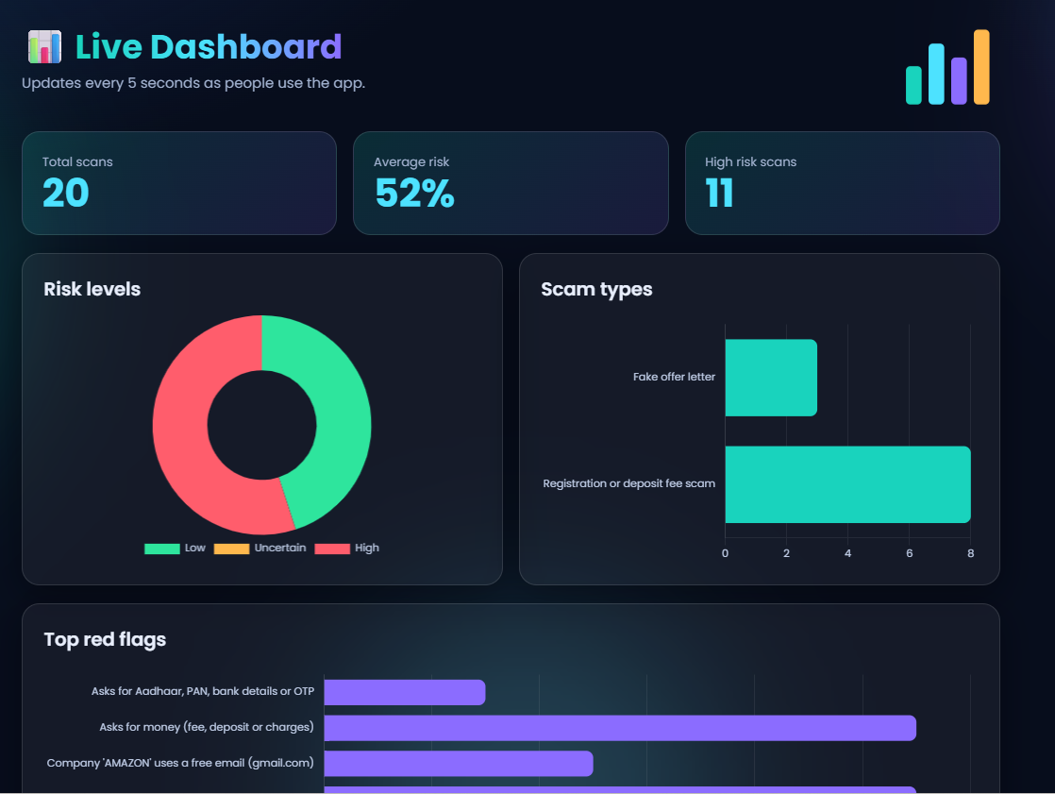
OUTPUT SCREENSHOT:
Notes:
Ask the audience: has anyone received a job offer that asked for money? Then explain the three common patterns, and mention that recruiters have the opposite problem with fake resumes.

Slide 14
Technology stack
TECHNOLOGY USED:
Layer | Tools
Front end | HTML, CSS, JavaScript, Chart.js
Back end | Python, Flask
ML and NLP | scikit-learn, SHAP or LIME, sentence-transformers
OCR and PDF | EasyOCR or Tesseract, pdfplumber
Data | EMSCAD, our own Indian-style test messages, sample resumes
Storage | SQLite for scan history and dashboard
ScamShield AI · 08
Notes:
The pages are plain HTML, CSS and JavaScript. Python and Flask run the model, OCR and resume checks behind them and return JSON to the page.

Slide 15
Conclusion:
ScamShield AI helps students check a job or internship offer before they pay.
It gives a clear risk score and shows why, so students can trust the result.
It supports recruiters with resume checks, and helps victims with a safe reply and a complaint draft.
Reviews, the live dashboard and the game build awareness for everyone.
It is a risk indicator, not proof, so students should always verify the company.
Notes:
Ask the audience: has anyone received a job offer that asked for money? Then explain the three common patterns, and mention that recruiters have the opposite problem with fake resumes.

Slide 16



Future work
WHAT COMES NEXT
Chrome extension
Telegram bot
Report database
DistilBERT
Placement cell view
Flag postings on LinkedIn and Naukri.
Forward a message to get a verdict.
Reused phone numbers and UPI IDs.
Compare with the baseline model.
Check companies before campus drives.
ScamShield AI · 12
Notes:
Present the placement cell view as a future deployment: it shows the project has a real institutional use.

Slide 17

Thank you
Questions?
ScamShield AI: Detect. Explain. Report. Protect, before you pay.
Notes:
Close with the tagline, then invite a judge to paste a real message and see the result.

